Slide 1
Decompensating effects in nuclear data integral benchmarking:
How to tag a specific xs ? example of ²³⁸U(n,n’), p(n,p) and ²³⁵U (or ²³⁹Pu) PFNS
David BERNARD
September 28, 2015@IAEA

Slide 2
OUTLINE: A recent example
Project oriented approach GEN-III + GEN-IV (ND uncertainties propagation)
Needed reduction of the number of Degree Of Freedom: Tag a specific XS (or ND in general) by using integral separate effects.
Perform new integral dedicated experiments (recent example)

Slide 3
Project oriented approach GEN-III+IV
(ND uncertainties propagation)
Constant σ=15%
French COMAC covariance
COMMARA-2 covariance
²³⁸U(n,n’) covariance matrices
  ²³⁸U covariance matrices amongst international evaluations
  (ENDF/B-VII, JENDL-4, TENDL-2009, French-COMAC)
  are not consistent
  A 15% standard deviation, constant with neutron energy, seems realistic

Slide 4
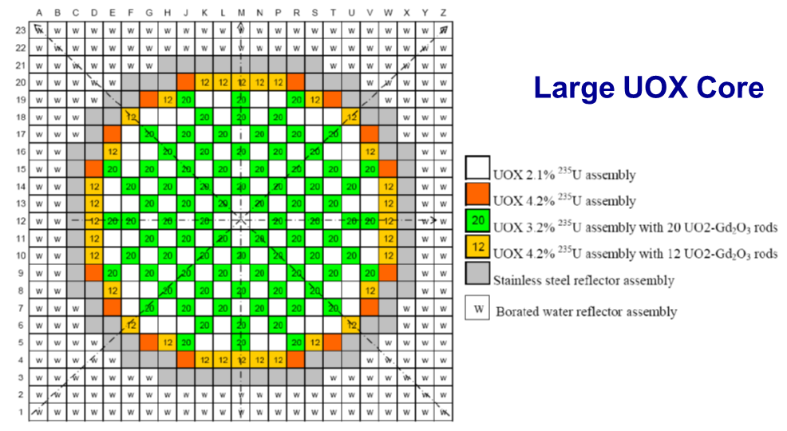
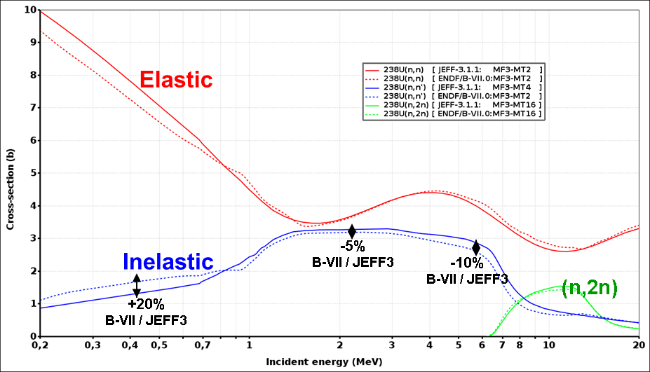
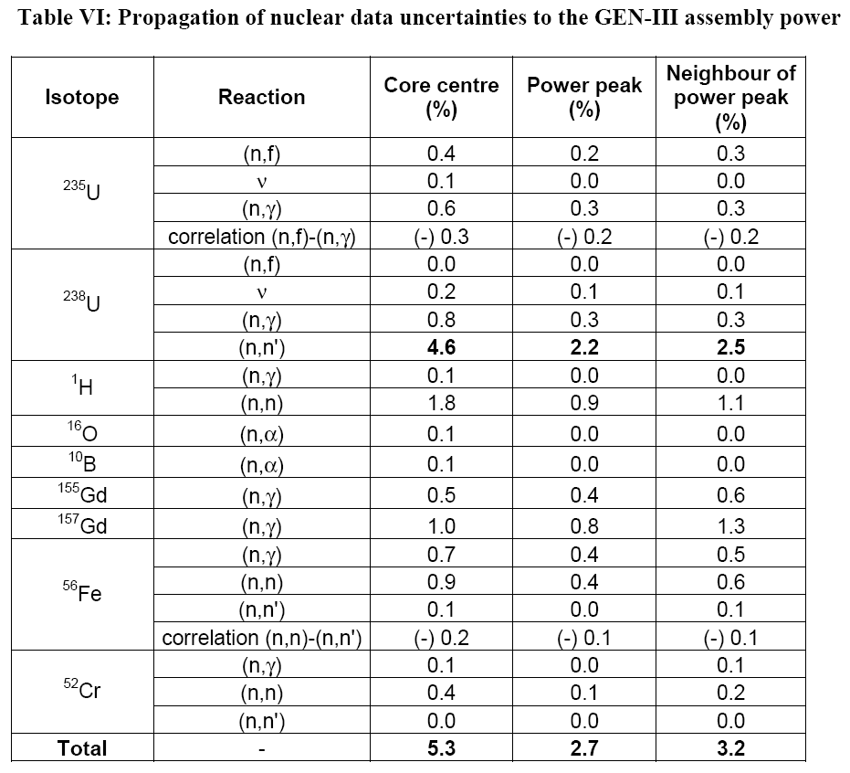
Project oriented approach GEN-III+IV
(ND uncertainties propagation)
OECD/UAM
Total uncertainty: 5.3% @1σ is more than the required target accuracy (1%) on PWR power map calculation.
²³⁸U(n,n’) takes 85% of this overall uncertainty.
+ around 3 to 4% for ²³⁵U PFNS !!!!!

Slide 5

Needed reduction of the number of Degree Of Freedom:
Integral trend tracking
First set: critical spheres (Radius r1) with fissile material
Second set: critical spheres (Radius r2) with the same fissile material are reflected by ²³⁸U
First order perturbation theory shows that the sensitivity to this reflector saving (r2-r1<0) can be expressed as S_{Reflector} = S(G)= S_{r2} –S_{r1}

Slide 6
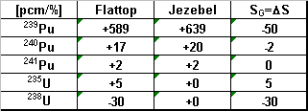
Needed reduction of the number of Degree Of Freedom:
Integral trend tracking
Proof by deterministic calculations:
Constraint by JEZEBEL k_{eff} uncertainties
639pcm/% = ΔExp / ΔPu239 → ΔPu239 = 200 / 639 ≈ 0.3%
Then, the reflector saving uncertainty due to ²³⁹Pu is about:
ΔG= 50pcm/% * 0.3% = 15 pcm.
-110pcm/%
S(G,²³⁸U) = S(G,²³⁸U(n,n’γ)+(n,n))
+ S(G,²³⁸U(n,f)+χ+ν)
+ S(G,²³⁸U(n,γ))
+ S(G,²³⁸U(n,xn))
+115pcm/%
-36pcm/%
+2pcm/%

Slide 7
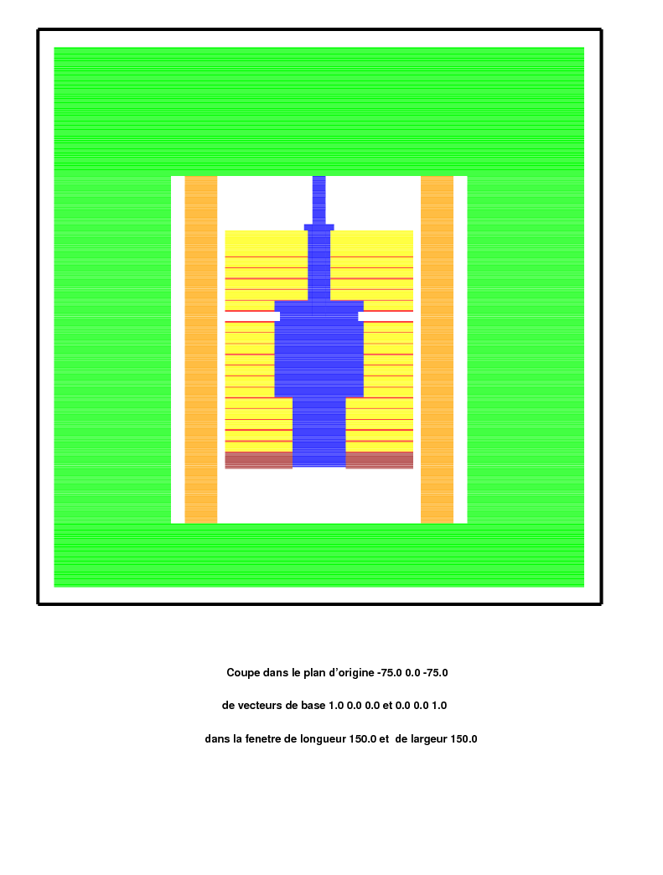
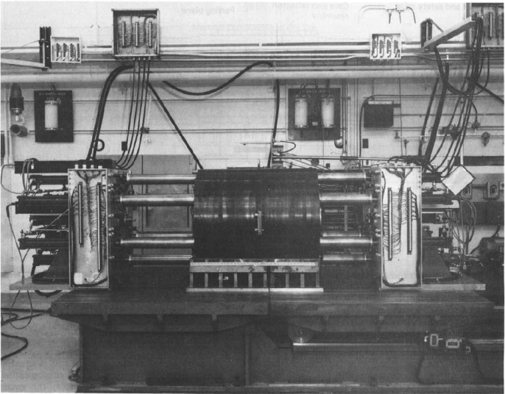
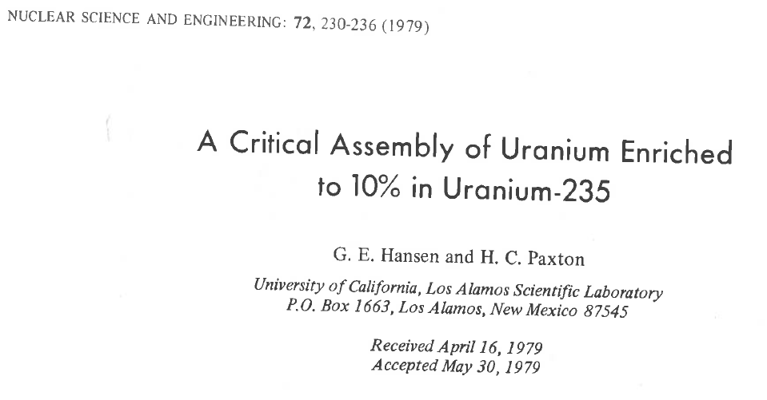
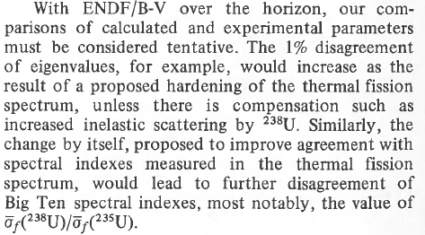
Needed reduction of the number of Degree Of Freedom:
Integral trend tracking
Large core k_{eff}: Big-10
Infinite core k_{eff}=k∞=1.0: SCHERZO+MINERVE+SNEAK8
(²³⁵U/²³⁸U=6.7% enrichment is needed to be just critical for infinite geometry)
avoiding so the sensitivity to Secondary Angular Distributions !!!

Slide 8


Needed reduction of the number of Degree Of Freedom:
Integral trend tracking
Integral Exp. with strong sensitivity to ²³⁸U(n,n’) are :
  Reactivity worth of ^{nat}U reflectors
      LANL U235 spheres
      Godiva bare sphere(HMF-001)
      Topsy(HMF-002), Flattop (HMF-028)
      Russian Pu spheres
      PMF-022, PMF-041, PMF-020
      LANL Pu spheres
      PMF-001, PMF-010, PMF-006
  Fast reactors with metallic U slightly-enriched fuel
      SCHERZO : K∞ = 1 (Minerve + Sneak)
      BIG-TEN : large critical core 10%²³⁵U
  σ_{f}^{U238}/σ_{f}^{U235} spectral index in U media
  (SCHERZO, ERMINE, BIG-TEN)
Fissile Pu sphere
U^{depleted}
reflector
VNIITF reflected Sphere
BIG-TEN: TRIPOLI4 geometry

Slide 9
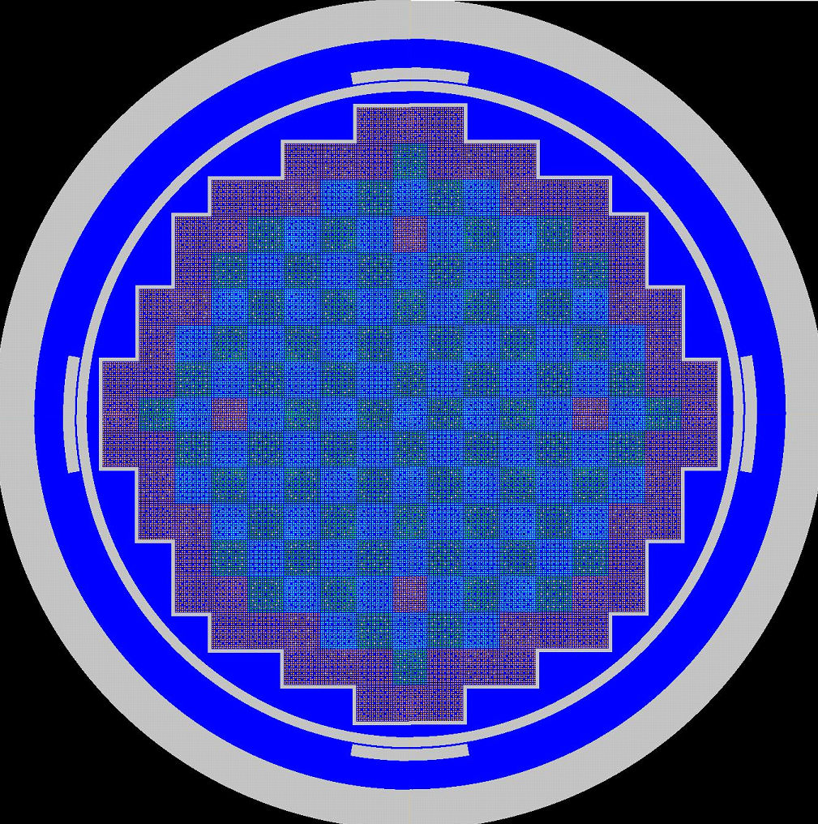
Needed reduction of the number of Degree Of Freedom:
Integral trend tracking
3D flux measurements in large PWRs :
  ⇒ Fission Chamber measurements at BOL HZP start-up : French N4 1500 MWe
N4 Radial cut
TRIPOLI4 geometry

Slide 10
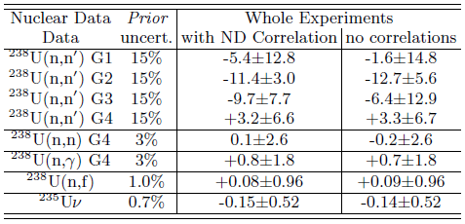
Needed reduction of the number of Degree Of Freedom:
Integral trend tracking
²³⁸U(n_{[2;5]MeV},n’γ) cross section (including so double differential XS)
seems to be overestimated by about (11±3)% in JEFF-3.1.1.
(note that a priori uncertainty was about 15%)
This result is not that much sensitive to correlation matrix.
Important remark: This trend is confirmed whatever the a priori uncertainty of ²³⁸U is

Slide 11
STEP3: confirm ND trend
Perform new integral dedicated experiments (recent example)

Slide 12
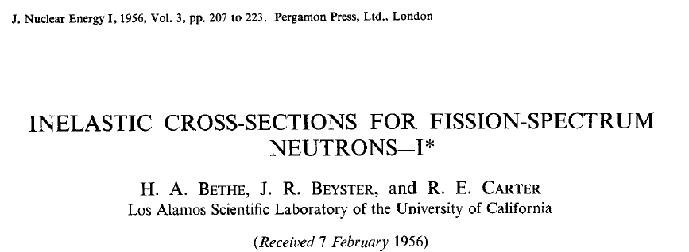
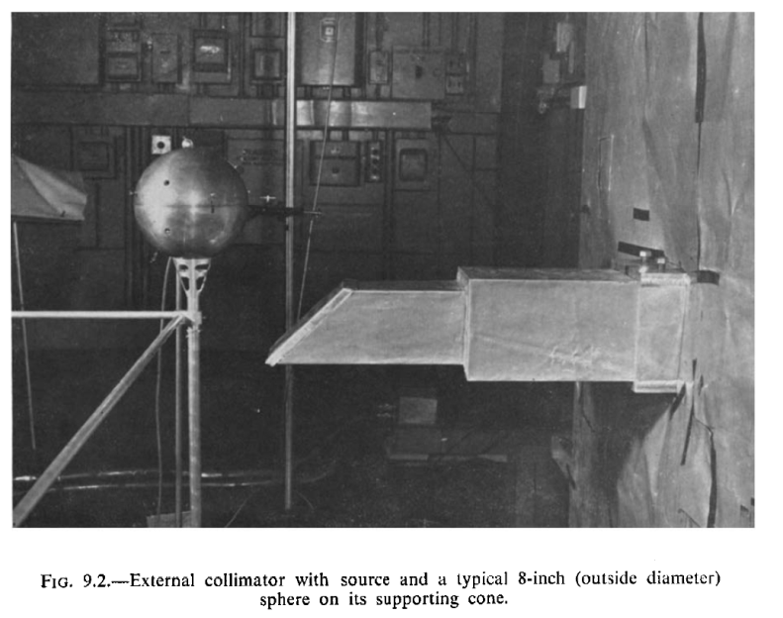
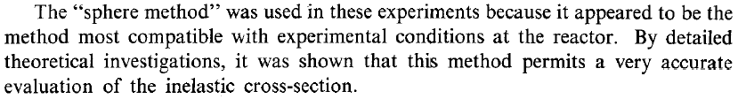
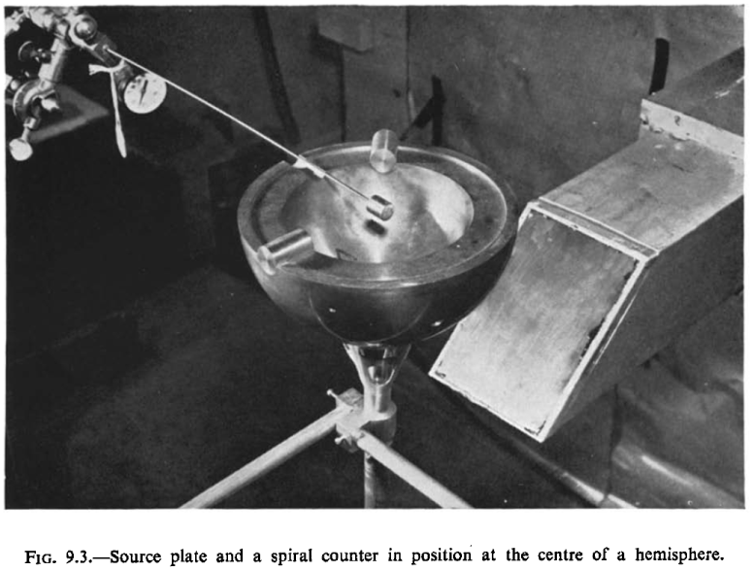

Principle OF the excalibur experiment
F(X) accounts for multiple scatterings
Transmission values measured by dosimeter detectors are linked to inelastic XS.

Slide 13

Principle OF the excalibur experiment
$$T(X)=F(X)e^{−σ_{inel}X}$$
$$S_{σ_{i}}^{T\left(X\right)}=\frac{∂T\left(X\right)}{{∂σ}_{i}}×\frac{σ_{i}}{T\left(X\right)}= δ_{\left(i=inel\right)}\left[−Xσ_{inel}\right]+δ_{\left(i≠inel\right)}\frac{σ_{i}}{F(X,σ_{i})}\frac{∂F(X,σ_{i})}{∂σ_{i}}$$
  ➔ Reduced degree of freedom compared with other integral experiments
  - much smaller sensitivity to the prompt fission neutron spectrum
  - negligible contributions from ²³⁵U or ²³⁹Pu cross sections
  Proof by Monte Carlo sensitivity calculations (direct calculations by modification of ENDF files)

Slide 14
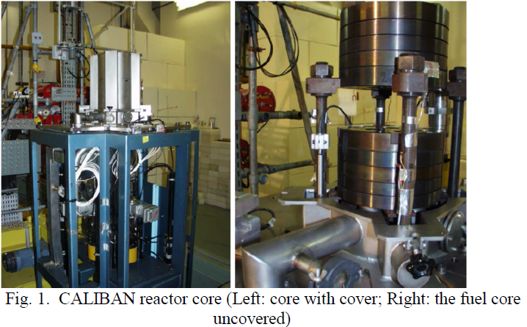
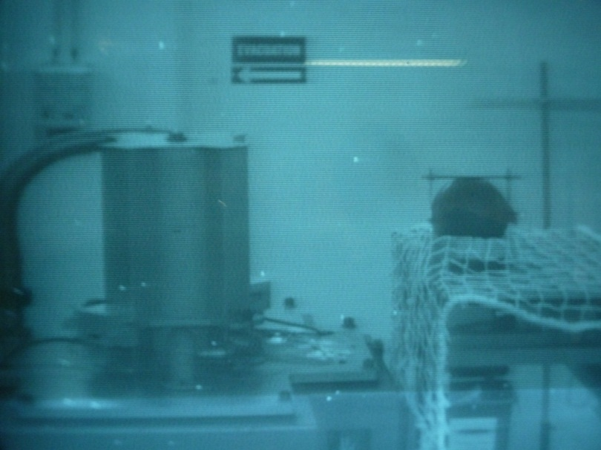
Experimental devices and set-up description
The highly Enriched Uranium non reflected core of CALIBAN (CEA Valduc) was a metal fast burst reactor (like the GODIVA reactor in US). It provided a quasi fast prompt fission neutron spectrum to a set-up made of ^{nat}U from which transmission measurement are performed.

Slide 15
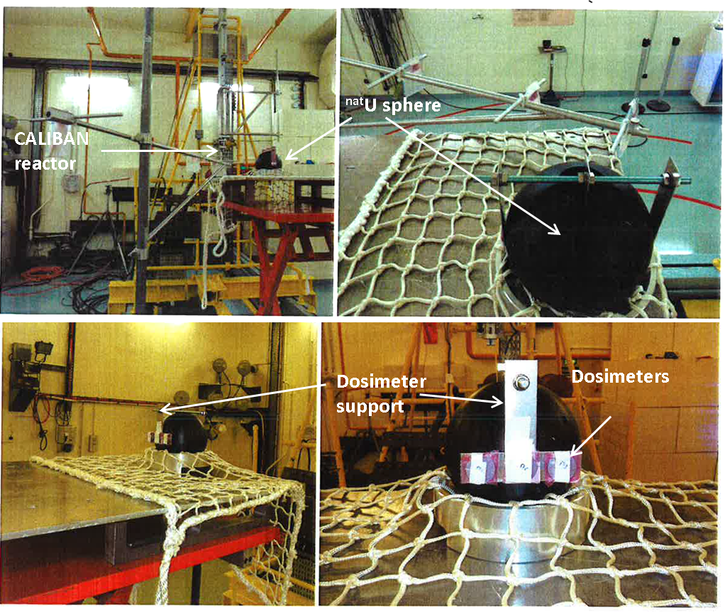
Experimental devices and set-up description, first phase; the Sphere

Slide 16
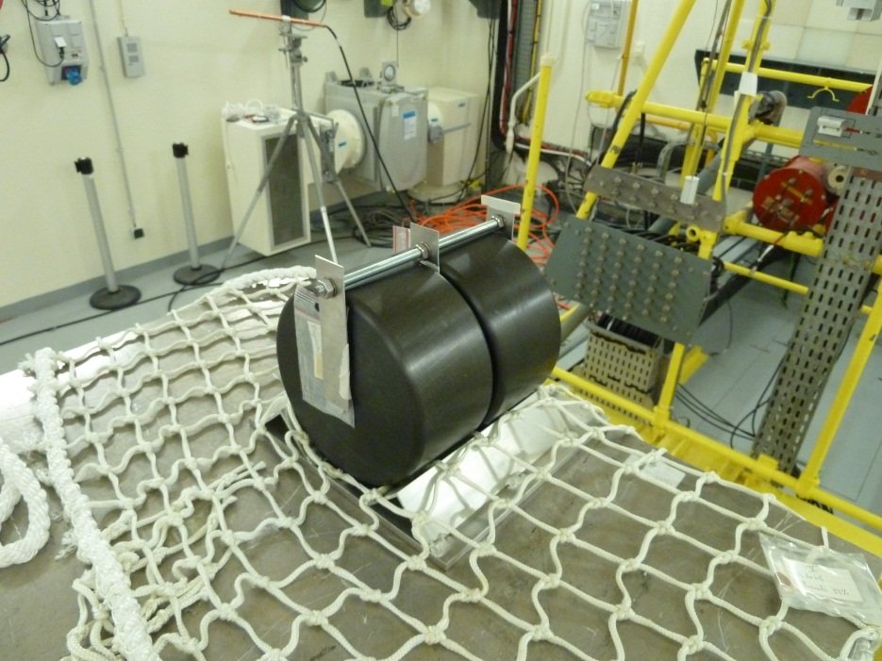
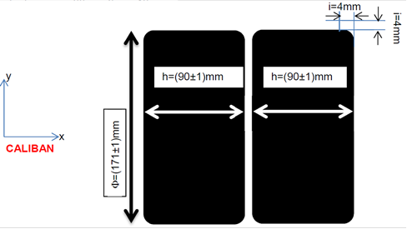
Experimental devices and set-up description, second phase; cylinders
Transmission material: 2 cylinders made of ^{nat}U (40kg each) located approximatively at 50cm from the center cavity of CALIBAN.
3 positions, X1 (entrance), X2 (middle) and X3 (exit) aim at measuring 3 neutron transmissions:
Transmission by the first cylinder: T(1X)
Transmissions by the two cylinders: T(2X)
Transmissions by the second cylinder only: T(2X)/T(1X)

Slide 17
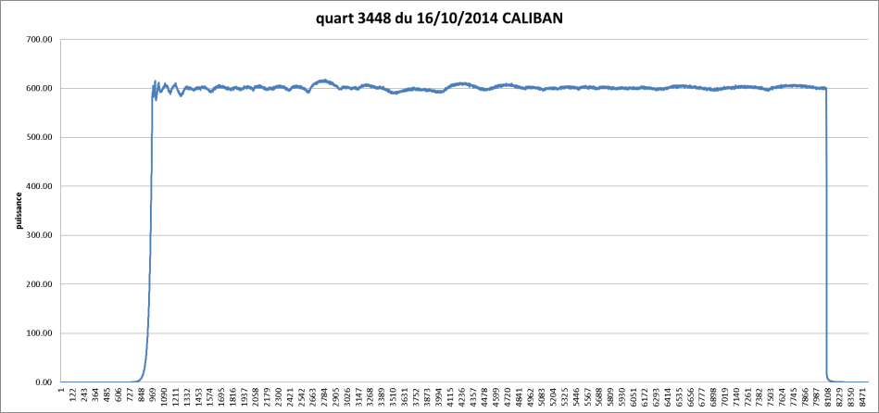
Experimental devices and set-up description
Two irradiations on the same week (2hours@600W) were performed with two series of dosimeters:
First irradiation: 3 Ni, 3 Fe, 3 Rh and 3 U8 dosimeters for transmission measurements and 1 U8 dosimeter for estimating the decay time correction
Second irradiation: 3 In, 3 Ti, 3 Mg, 2 U5 and 3 U8 dosimeters for transmission measurements and 2 U8 and 1 U5 dosimeters for estimating the decay time correction.
“E50%” stands for the median energy for individual dosimeter reactions induced by a ²⁵²Cf spontaneous neutron fission source

Slide 18
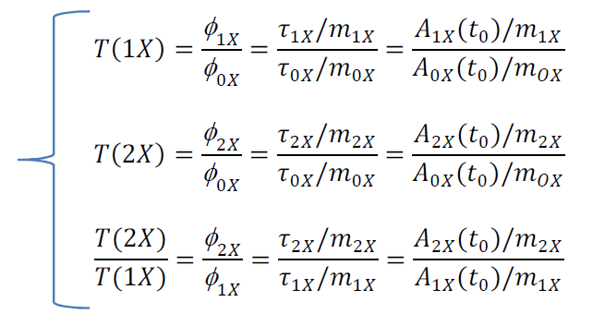
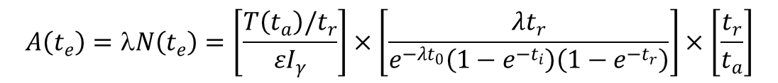
Rough data and first experimental results
Dosimeter activities were counted using γ-spectrometry
All measurements were duplicated in time (and were done sometimes in different laboratories, involving different teams, detector geometries, acquisition chains and software).
$$A\left(t_{e}\right)=λN\left(t_{e}\right)=\left[\frac{T\left(t_{a}\right)/t_{r}}{εI_{γ}}\right]×\left[\frac{λt_{r}}{e^{−λt_{0}}\left(1−e^{−t_{i}}\right)\left(1−e^{−t_{r}}\right)}\right]×\left[\frac{t_{r}}{t_{a}}\right]$$
Including net Count rate during the active acquisition time Δt_{a}.
75 transmissions measured (±3%) !!
Interpretation is on-going !!!
Leading to reach the targeted accuracy

Slide 19
Not the end of the story !!!!
Improving ²³⁸U(n,n’) is needed but is maybe not enough.
Modifications of ²³⁵U PFNS impact integral calculations…not in the good direction sometimes….
Soften PFNS is neutronically equivalent
to increase high energy neutron scattering !!!!
Both are strongly linked in integral analysis…except for transmissions experiments

Slide 20
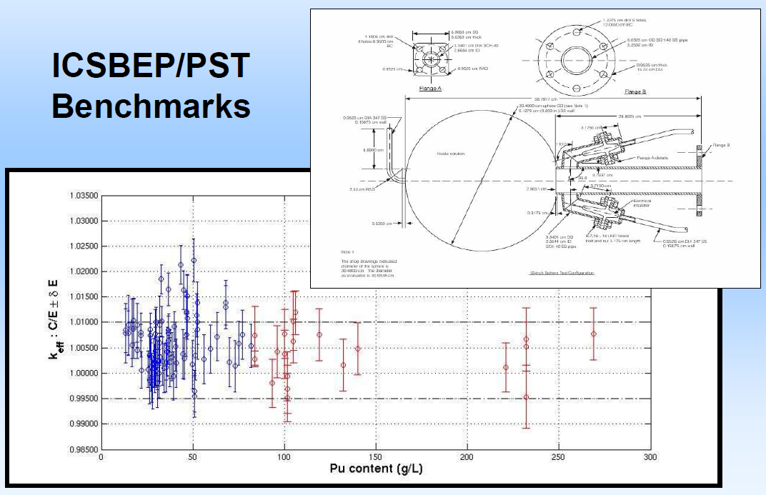
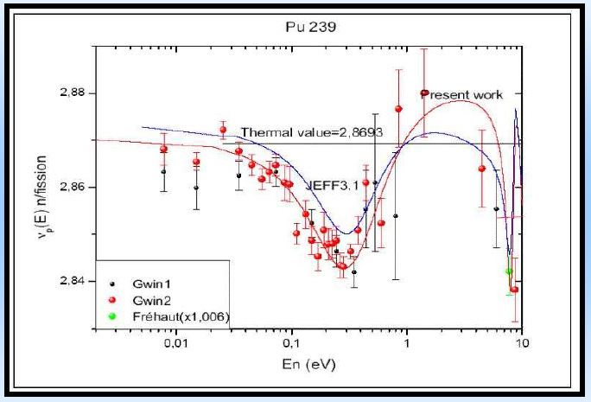
ANOther example for a needed decompensation
For a very long time, ICSBEP/PST solutions are supposed to be sensitive to ²³⁹Pu thermal and subthermal η value. That’s fully right !!!! But to neutron leakage as well…(PFNS + scattering at high energy)

Slide 21
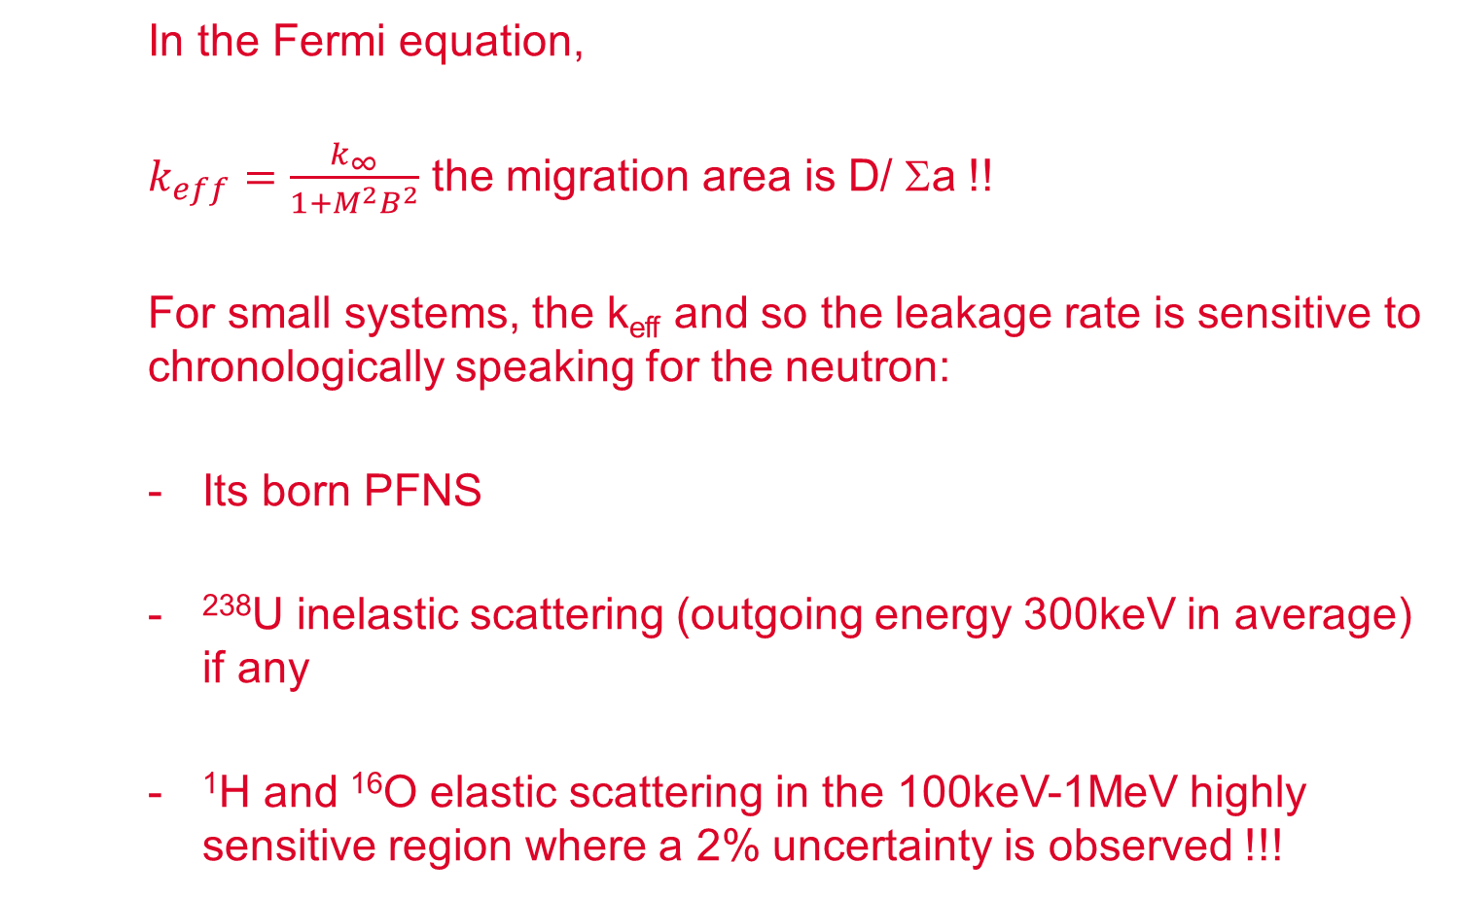
Other example for a needed decompensation
In the Fermi equation,
$k_{eff}=\frac{k_{∞}}{1+M^{2}B^{2}}$ the migration area is D/ Σa !!
For small systems, the k_{eff} and so the leakage rate is sensitive to chronologically speaking for the neutron:
Its born PFNS
²³⁸U inelastic scattering (outgoing energy 300keV in average) if any
¹H and ¹⁶O elastic scattering in the 100keV-1MeV highly sensitive region where a 2% uncertainty is observed !!!

Slide 22
Decompensating XS effects
New experiments to be done:
Fast neutron transmission in
Hydrogen media
Oxygen media
PFNS has to be well assessed at the same time (mean value AND uncertainties see dosimetric activities in the dedicated CRP@IAEA)

Slide 23
CONCLUSIONS
Nuclear Data analysis of PST-k_{eff}, Void effect, Doppler, β_{eff} in FBR, power map in PWR… are suffering to ND compensation (XS, PFNS)
Specific isotope transmission experiments are needed to decompensate effects.
The goal is to improve ND evaluations and to give constraints on covariances as well !

